Slide 1
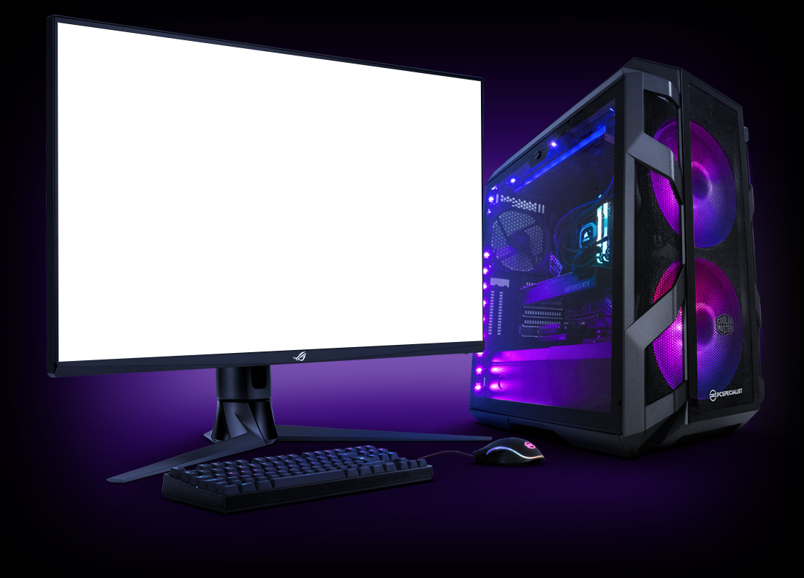

Slide 2
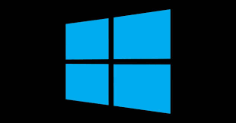

Slide 3
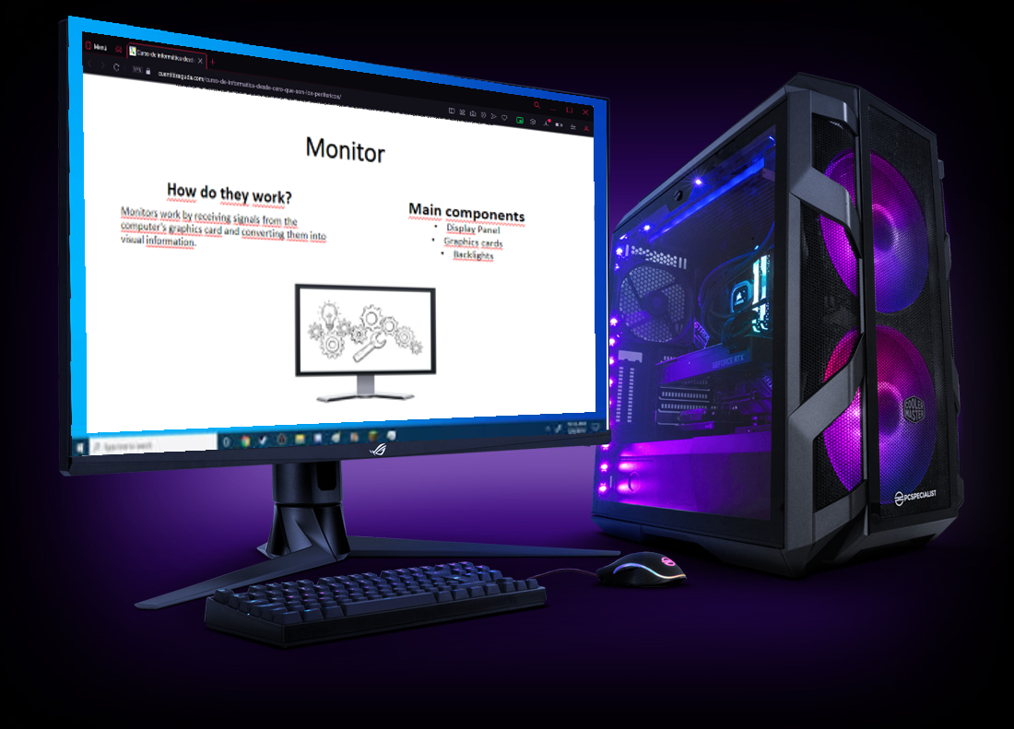

Slide 4
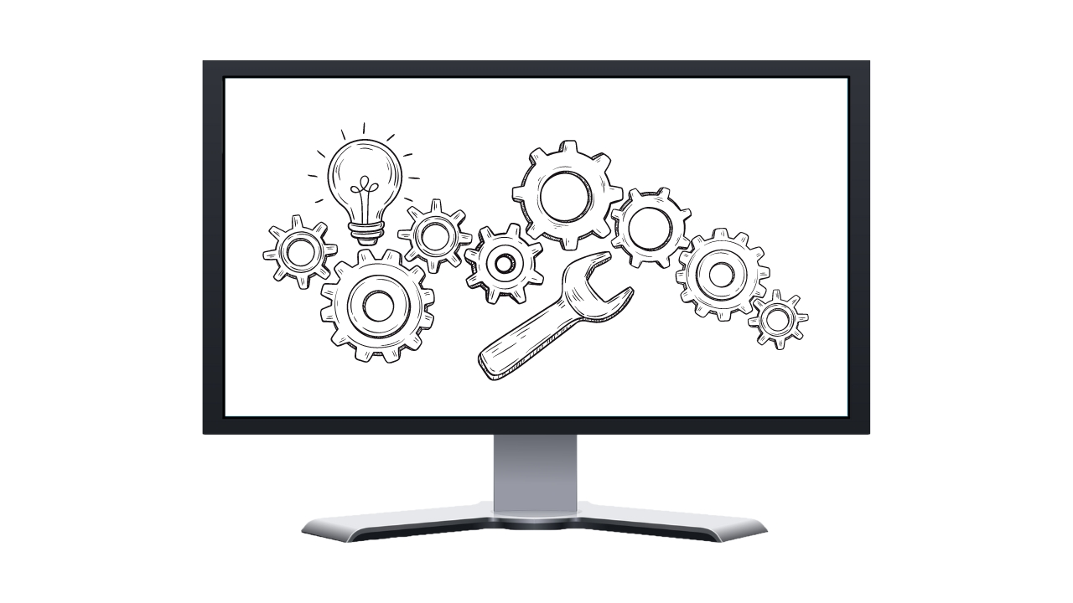
Monitor
How do they work?
Monitors work by receiving signals from the computer's graphics card and converting them into visual information.
Main components
Display Panel
Graphics cards
Backlights

Slide 5
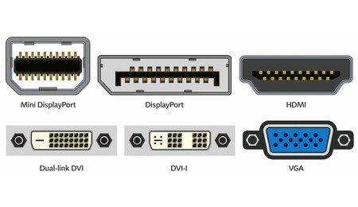
Connection type
VGA (Video Graphics Array)
DVI (Digital Visual Interface)
HDMI (High Definition Multimedia Interface)
DisplayPort
USB-C

Slide 6
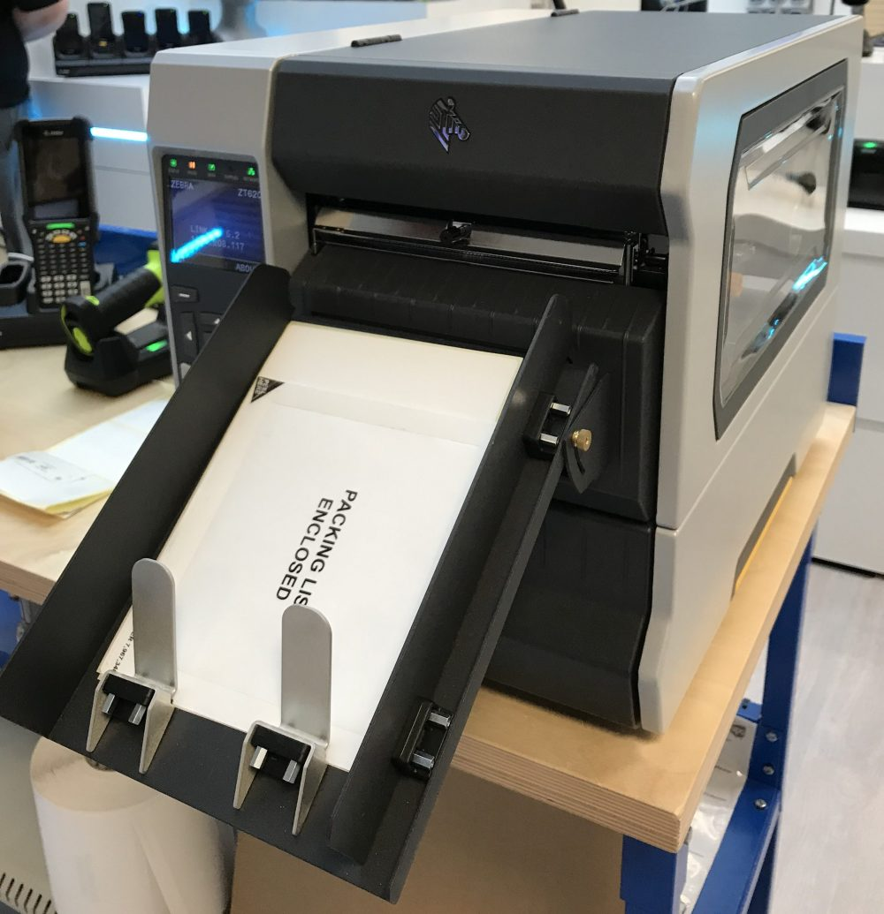
Printers (Thermal transfer printer)
Main Features
How they work?
Thermal print head
Thermal ribbon or paper
Pressure roller
The thermal print head selectively heats areas of the thermal ribbon or paper and transfers ink or wax to the paper to create the desired text or image.

Slide 7
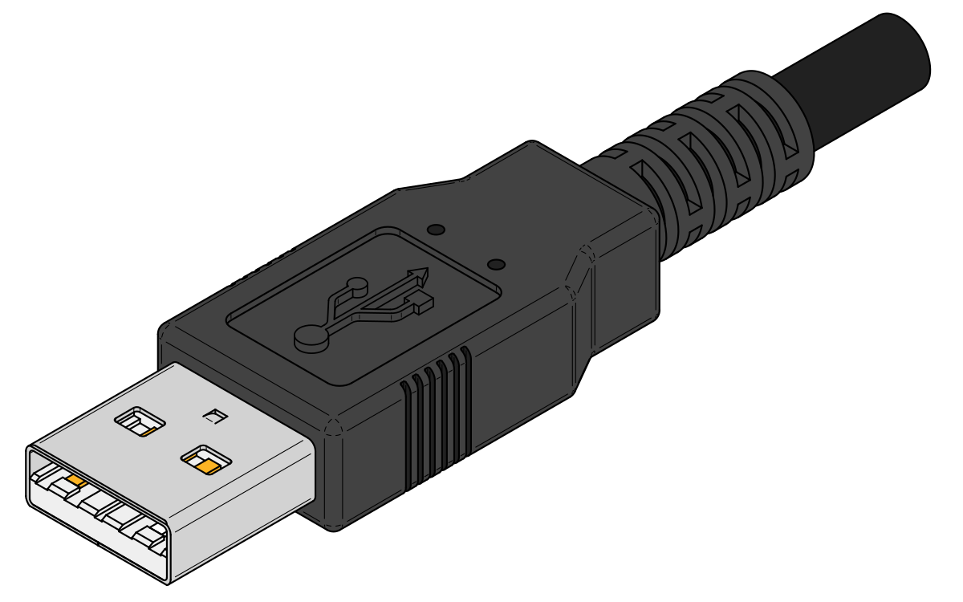
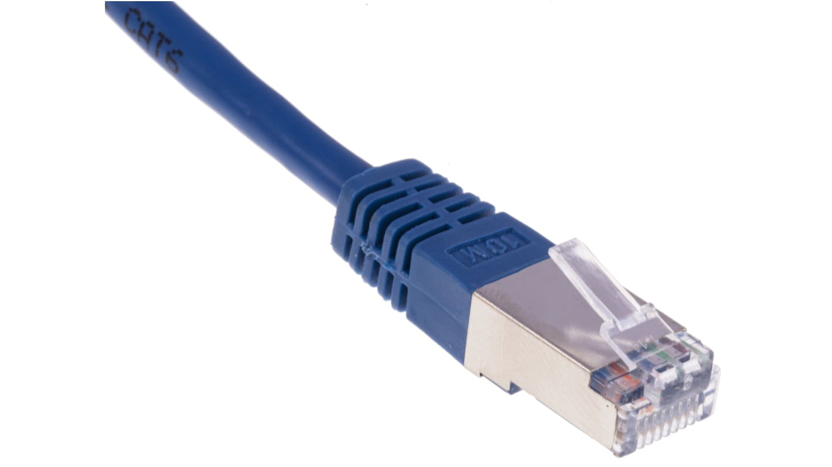
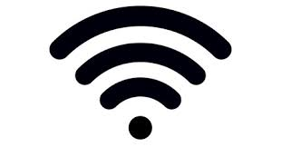
Connection Types
USB
Ethernet
Wi-Fi

Slide 8
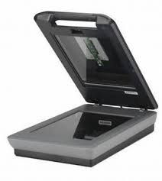
Scanner
How they work?
Main components
The scanner illuminates the document with light and the sensors (CIS or CCD) capture the reflected light, creating a digital image.
CIS or CDD sensors
Scanning head
Dish or glass plate

Slide 9
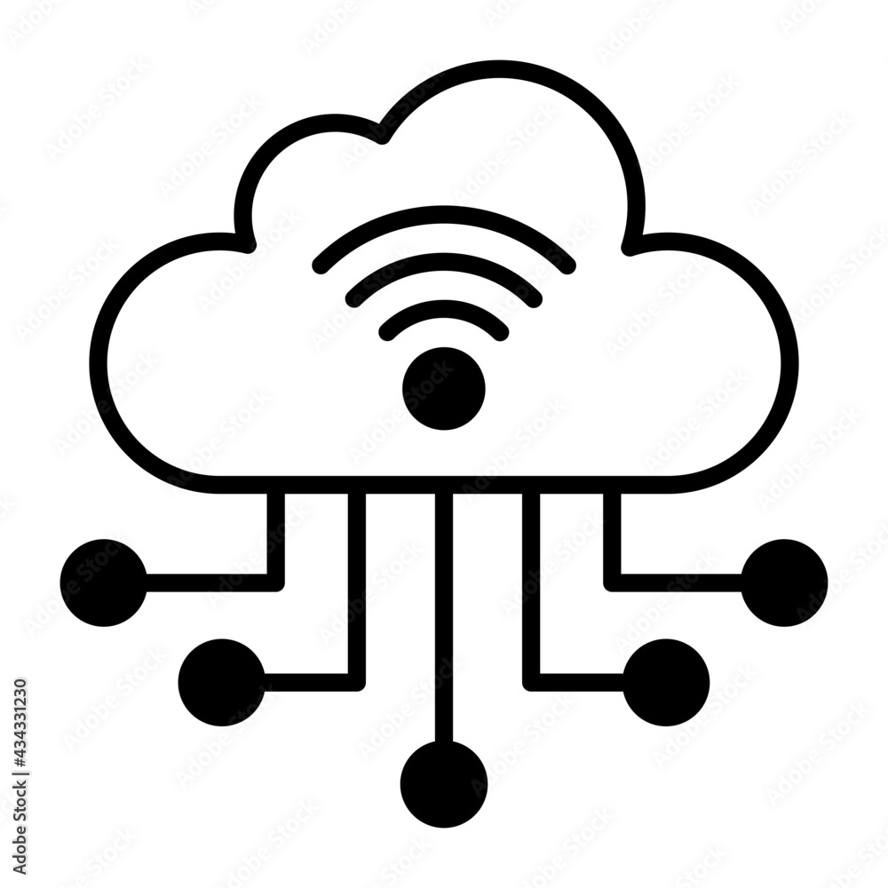
Connection types
USB
Wi-Fi
Ethernet
Cloud integration

Slide 10
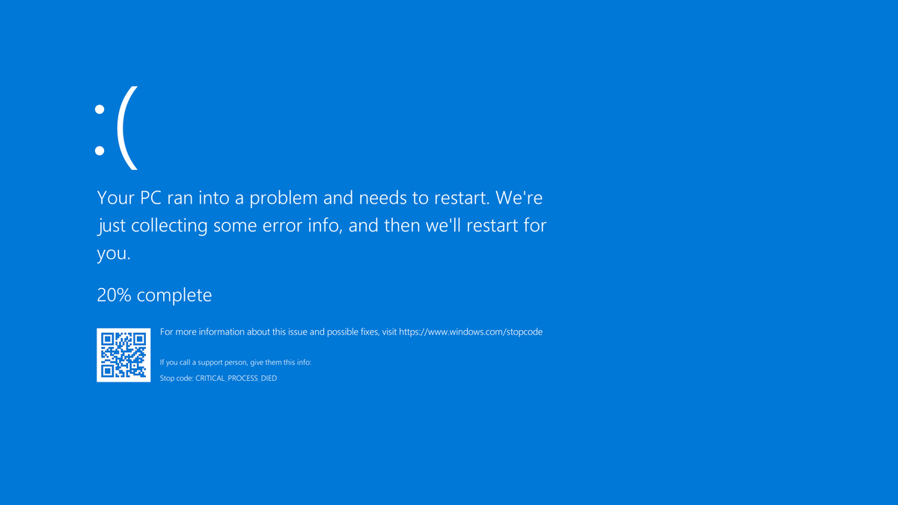

Slide 11
